Slide 1
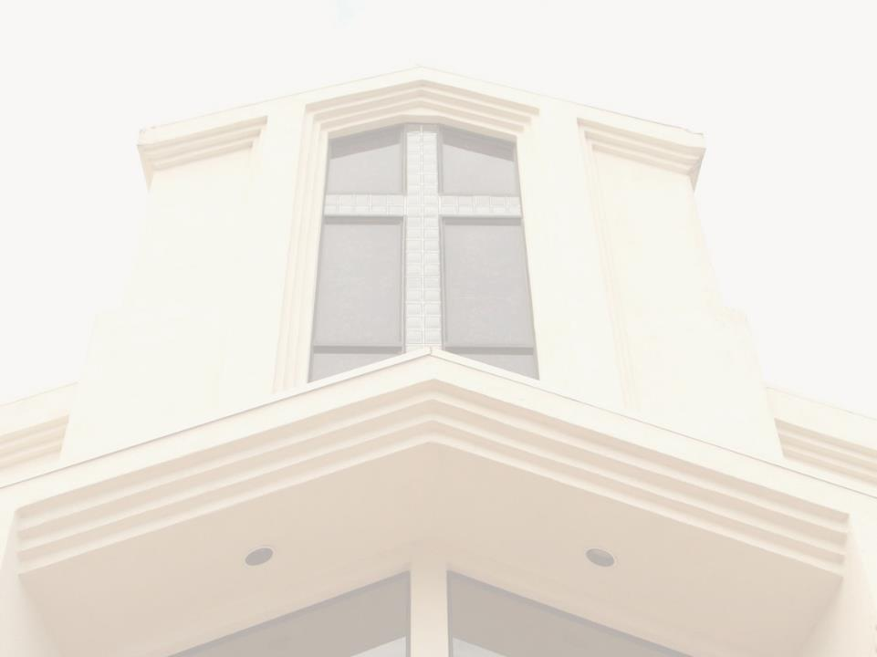
Ordination and Missionary Sending Service of Emily Chao
趙安恬傳道按立和差派典禮
Please silent your phone
请您静音您的手机

Slide 2
Prelude
宣召
Again Jesus said, “Peace be with you! As the Father has sent me, I am sending you.” - John 20:21
耶 穌 又 對 他 們 說 ： 願 你 們 平 安 ！ 父 怎 樣 差 遣 了 我 ， 我 也 照 樣 差 遣 你 們 。
- 約 翰 福 音 20:21

Slide 3
Give of Your Best to the Master
將你最好的獻於主

Slide 4
Give of your best to the Master;
Give of the strength of your youth;
Throw your soul’s fresh, glowing ardor
Into the battle for truth.
Jesus has set the example,
Dauntless was He, young and brave;
Give Him your loyal devotion;
Give Him the best that you have.
將你最好的獻於主
獻你年輕的力量
將你純潔熱情心靈
忠心為真理打仗。
主耶穌已做你榜樣
勇敢堅定不懼怕
你要忠心敬虔愛主
將最好奉獻與祂

Slide 5
Give of your best to the Master;
Give of the strength of your youth;
Clad in salvation’s full armor
Join in the battle for truth.
將你最好的獻於主
獻你年輕的力量
穿上救恩全副軍裝
忠心為真理打仗。

Slide 6
Give of your best to the Master;
Give Him first place in your heart;
Give Him first place in your service;
Consecrate every part.
Give, and to you will be given;
God His beloved Son gave;
Gratefully seeking to serve Him,
Give Him the best that you have.
將你最好的獻於主
主在你心居首位
主在事業上居首位
完全奉獻不收回
樂意施捨必得賞賜
因神將愛子賜下
你要向主感恩事奉
將最好奉獻與祂

Slide 7
Give of your best to the Master;
Give of the strength of your youth;
Clad in salvation’s full armor
Join in the battle for truth.
將你最好的獻於主
獻你年輕的力量
穿上救恩全副軍裝
忠心為真理打仗。

Slide 8
Give of your best to the Master;
Naught else is worthy His love;
He gave Himself for your ransom,
Gave up His glory above.
Laid down His life without murmur,
You from sin’s ruin to save;
Give Him your heart’s adoration;
Give Him the best that you have.
將你最好的獻於主
主愛偉大無可比
祂將自己做你贖價
天上榮耀賞賜你
祂捨生命毫無怨言
救你脫罪把血洒
你要熱心敬虔愛主
將最好奉獻與祂。

Slide 9
Give of your best to the Master;
Give of the strength of your youth;
Clad in salvation’s full armor
Join in the battle for truth.
將你最好的獻於主
獻你年輕的力量
穿上救恩全副軍裝
忠心為真理打仗。

Slide 10
Invocation 禱告

Slide 11
Scripture Reading 讀經 1Tim 4:10-16 提摩太前書4:10-16
10 That is why we labor and strive, because we have put our hope in the living God, who is the Savior of all people, and especially of those who believe.11 Command and teach these things.
10我們勞苦努力，正是為此，因我們的指望在乎永生的神；他是萬人的救主，更是信徒的救主。11這些事，你要吩咐人，也要教導人。

Slide 12
Scripture Reading 讀經 1Tim 4:10-16 提摩太前書4:10-16
12 Don’t let anyone look down on you because you are young, but set an example for the believers in speech, in conduct, in love, in faith and in purity.
12不可叫人小看你年輕，總要在言語、行為、愛心、信心、清潔上，都作信徒的榜樣。

Slide 13
Scripture Reading 讀經 1Tim 4:10-16 提摩太前書4:10-16
15 Be diligent in these matters; give yourself wholly to them, so that everyone may see your progress. 16 Watch your life and doctrine closely. Persevere in them, because if you do, you will save both yourself and your hearers.
15這些事你要殷勤去做，並要在此專心，使眾人看出你的長進來。16你要謹慎自己和自己的教訓，要在這些事上恆心；因為這樣行，又能救自己，又能救聽你的人。

Slide 14
Scripture Reading 讀經 1Tim 4:10-16 提摩太前書4:10-16
13 Until I come, devote yourself to the public reading of Scripture, to preaching and to teaching. 14 Do not neglect your gift, which was given you through prophecy when the body of elders laid their hands on
13你要以宣讀、勸勉、教導為念，直等到我來。14你不要輕忽所得的恩賜，就是從前藉著預言、在眾長老按手的時候賜給你的。

Slide 15
Minister Examination Report 傳道考察報告 1/2
2016年8月20日經由執委會通過千橡城基督教會承認合格會員為傳道所根據的原則：
會員身份：以千橡城基督教會為母會
裝備：由牧長團認可的神學院畢業
意願：同意接受這個職稱和責任
確認：經過牧長團面談並獲得牧長團支持
牧長團定期（建議一年一次）核查傳道人，若建議並通過採取撤銷職稱的行動，則由執委會通知該傳道人

Slide 16
Minister Examination Report 傳道考察報告 2/2
認可趙安恬為傳道人
會員身份：千橡城基督教會是趙安恬的母會
裝備：2016年由惠頓大學畢業，獲跨文化研究與宣教碩士學位。惠頓大學為牧長認可。
意願：趙安恬同意接受這個職稱和責任
經過牧長團考察面談後獲得確認
千橡城基督教會作為差派教會，將按照與趙安恬宣教士和相關差傳機構達成的協議，設專有團隊定期了解趙安恬的心身靈、事工、財務各方面的情況並給予支持，也鼓勵趙安恬對千橡城基督教會的宣教事工給予建議和推動。

Slide 17
Missionary Examination Report 差傳考察報告 1/2
Emily Chao 趙安恬
Joined CCCTO Since Childhood 1993
Fluent in English, advanced in Mandarin, beginner in Cantonese
BA in English Literature from UCSB in 2011
Studied and taught in China
MA in Intercultural Studies and Missions from Wheaton College in 201​6
Ministered at CCCTO and CCSV
Mission work in China, Indonesia and other parts of Asia

Slide 18
Missionary Examination Report 差傳考察報告 2/2
Mission field in Hong Kong SAR, China
Mission organization is Pioneers www.pioneers.org
Minister to Muslim women and children (refugees, migrant workers, immigrants)
Plan to stay January 2017-indefinite (at least 2 years)
Focus on education language tutoring of Muslim refugees and migrant workers (women and children), volunteer administration support for local Christian NGO, and hospitality/friendship ministry to the Muslim community.

Slide 19
ORDINATION 按立儀式

Slide 20
SENDING 差派儀式

Slide 21
Charge to the Candidate 訓勉新傳道宣教士
By Rev. Youping Wang 王友平牧師

Slide 22
On Being an Example of Servant of God (1/8)
We celebrate today the Ordination and Missionary Sending Service of Emily Chao, who is our first home-grown CCCTO missionary to be send out. This is indeed a happy day for us, and let’s welcome her. May all glory and honor be given to Him.
From the Scripture just read: I Tim. 4: 10-16, I want to emphasize vs. 12: “Do not let anyone look down on you because of

Slide 23
On Being an Example of Servant of God (2/8)
are young, but set an example for the believers in speech, in life, and love, in faith and in purity.”
I want to bring few words of exhortation to Emily as an evangelist. Why does Paul say: “Don’t let anyone look down on you because are young”? Could it be that some members of the congregants were well into age, and they may have not listened to the young preacher,

Slide 24
On Being an Example of Servant of God (3/8)
Timothy? Paul’s point is to set an example for believers. Likewise, I want to encourage you in the Gospel work since you are being ordained as an evangelist and a full-time missionary, and entering the leadership of Church ministry. From now on you are to please the Lord Jesus.
Emily the Evangelist, “What does the Lord want you to do?”

Slide 25
On Being an Example of Servant of God (4/8)
The Key issue is to become an example to all believers, continually, in all circumstances so that they don't look down on you because you are young. This is the Lord’s command to you. Also being an example of your faith is like leaving a “footprint, or model” of your conduct in words and actions to believers in their ears, hearts.

Slide 26
On Being an Example of Servant of God (5/8)
It is also recorded in God’s Book of Life. Your words can influence the future or even the destiny of those with whom you contact. That’s why Paul says “Watch your life and doctrine closely. Persevere in them, because if you do, you will save both yourself and your hearers.” on the verses 16.

Slide 27
On Being an Example of Servant of God (6/8)
What are the requirements for being an example to believers?
1. Speech: Be careful in your speech whether in public or in private situations. There are many warnings from the Scripture on the use of our tongue.
2. Conduct: Your daily activities and conduct must be conducive to
3. Purity of Life based on the principles of conduct found in the Scriptures.

Slide 28
On Being an Example of Servant of God (7/8)
4.Love: The Love of the Lord Jesus Christ be exemplified in your life, so that your life is one that is contagious to others.
5.Faith: Your faith in Christ will guide you through your failures, weakness, and let believers see you are only human. Then your faith will become victorious through active obedience and thus helping others in return.

Slide 29
On Being an Example of Servant of God (8/8)
May you be like Paul who said, “Follow my example as I follow the examples of Christ.” (I Cor. 11:1). Thus you will bring others to become missionary warriors for Christ.
Finally, I exhort the members of CCCTO to pray constantly for you, and offering themselves for missionary service in His Kingdom, revive the Church and to enhance the vision and ministries of the Great Oaks Ministries Association.

Slide 30
Response by the Candidate 回應及述志
By Emily Ann Chao 趙安恬

Slide 31
回應及述志 (1/6)
謝謝各位來參加這個特別的典禮。今天是我人生中一個重要的里程碑，我很高興能與大家一起分享這個值得紀念的時刻。
謝謝王牧師的訓勉，鼓勵我在行事為人上做榜樣。我會將提摩太前書4章銘記在心，時時提醒自己在言語，行為，愛心，信心和清潔上，學像基督，做眾人的榜樣。這對我將來在香港穆斯林社團中的服侍是非常重要的功課。

Slide 32
回應及述志 (2/6)
我相信千橡基督教會也是為這個目的而裝備我的，我很感謝教會養育了我，在座有很多長輩是看著我長大的。從我四歲參加主日學和AWANA 的幼兒班，一直到中學參加青年團契，千橡基督教會始終用聖經的真理餵養我，教導我學習基督的樣式去服事，並且點燃我心中對宣教的熱情。雖然我父母對我靈命的成長也有很大的影響，但若沒有教會，他們很難獨自完全這個工作。

Slide 33
回應及述志 (3/6)
有人說，“養大一個孩子，得花上整個村子的力氣。”在我來說，我的成長可是花了整個教會的力氣。過去二十多年，教會以不同方式供應了我，才培養出今天的這個宣教士。
特別感謝神，讓我在高中時能參加教會的短宣。有幾個暑假我們在亞利桑那州為印第安人小孩辦夏令聖經班。對那些失落的孩子，我很自然就產生一種愛憐，服侍他們時心中充滿喜樂。從第一次短宣，我就

Slide 34
回應及述志 (4/6)
起了一個心願：“長大以後我就要做這種工作！” 對教導、傳福音的興趣，在我大學去中國的幾次短宣中，變得越來越濃厚。後來神呼召我做全時間的宣教工作，所以我大學畢業之後，就到中國的大學教英文，並向學生傳福音。就在那裡，神給我一個新的呼召，就是在穆斯林當中工作。從中國回來後，我就進入惠頓大學讀碩士，主修跨文化宣教，偏重於穆斯林事工研究。

Slide 35
回應及述志 (5/6)
過去一年，我有機會認識到在香港有廣大的穆斯林群體，神也透過一些宣教士鼓勵我，讓我體會到這個廣大的禾場已經熟了，極其需要工人來收割。
謝謝每一位在禱告和經濟上支持我的弟兄姐妹。是你們幫助我完成到亞洲向穆斯林宣教的呼召和心願。我可以坦然地向前行，知道是一個堅固的教會差派我出去，並且用禱告做我的後盾。

Slide 36
回應及述志 (6/6)
作為千橡基督教會第一個土生土長的宣教士，我祈求神繼續在我們教會中興起更多的宣教士，前仆後繼地在宣教工場為福音作戰，完成耶穌在離開世界之前託付給所有信徒的大使命，就是將福音傳給萬邦。謝謝！

Slide 37
Presentation of Certificates 頒發傳道證書和宣教士證書

Slide 38
Presentation of Souvenir Gift 贈送紀念品

Slide 39
I am here Hi-Ne-Ni 我在这里 Hi-Ne-Ni 1/2
Yahweh! O my LORD my God
Come and help me forsake my love
Forsake my love, my all Yahweh!
O my LORD my God
Help me break down all my idols, Idols in my heart
Till I give myself in worship as a sacrifice
With no regrets, No turning back
Till I at the altar hear the calling for my life
With no regrets, Here I am
耶和华我的主啊 !
求你使我放下心中 心中所爱
耶和华我的主啊 !
求你使我打碎心中 心中偶像
直到我在敬拜中献上自己为祭
无怨 无悔 永不回头 永不回头
直到我在祭坛那里得着命定
无怨 , 无悔 我在这里 我在这里

Slide 40
I am here Hi-Ne-Ni 我在这里 Hi-Ne-Ni 2/2
Hi-Ne-Ni , Hi-Ne-Ni
Purge me, Send me Yes! Here I am
Hi-Ne-Ni , Hi-Ne-Ni
Purge me, Send me, Hi-Ne-Ni
For the darkest corners of the world
O LORD! Send me!
For the souls hopeless in despair, Here I am!
Yes! Here I am, Hi-Ne-Ni
Yes! Here I am, Hi-Ne-Ni
Hi-Ne-Ni Hi-Ne-Ni
烧我 , 差我 , 我在这里
Hi-Ne-Ni Hi-Ne-Ni
烧我 , 差我 Hi-Ne-Ni
为这世界黑暗的角落
为那不曾被安慰的灵魂
我在这里 Hi-Ne-Ni
我在这里 Hi-Ne-Ni

Slide 41
I am here Hi-Ne-Ni 我在这里 Hi-Ne-Ni

Slide 42
Yahweh! O my LORD my God
Come and help me forsake my love
Forsake my love, my all Yahweh!
O my LORD my God
Help me break down all my idols, Idols in my heart
耶和华我的主啊 !
求你使我放下心中放下心中所爱
耶和华我的主啊 !
求你使我打碎心中 心中偶像

Slide 43
直到我在敬拜中献上自己为祭
无怨 无悔 永不回头
直到我在祭坛那里得着命定
无怨 , 无悔 我在这里 我在这里
Till I give myself in worship as a sacrifice
With no regrets, No turning back
Till I at the altar hear the calling for my life
With no regrets, Here I am
Hi-Ne-Ni , Hi-Ne-Ni
Purge me, Send me
Yes! Here I am

Slide 44
Hi-Ne-Ni , Hi-Ne-Ni
Purge me, Send me
Yes! Here I am
Hi-Ne-Ni , Hi-Ne-Ni
Purge me, Send me
Hi-Ne-Ni
Hi-Ne-Ni Hi-Ne-Ni
烧我 , 差我 , 我在这里
Hi-Ne-Ni Hi-Ne-Ni
烧我 , 差我
Hi-Ne-Ni

Slide 45
For the darkest corners of the world
O LORD! Send me!
For the souls hopeless in despair,
Here I am!
Yes! Here I am, Hi-Ne-Ni
Yes! Here I am, Hi-Ne-Ni
为这世界黑暗的角落
我在这里
为那不曾被安慰的灵魂
我在这里 Hi-Ne-Ni
我在这里 Hi-Ne-Ni

Slide 46
Benediction 祝禱

